Slide 1

7th Grade Math
Unit 11, Lesson 9 Revisiting Relationships in Circles Volume 2, pg. 192

Slide 2


Benchmarks
MA.7.GR.1.3
Explore the proportional relationship between circumferences and diameters of circles. Apply a formula for the circumference of a circle to solve mathematical and real-world problems.
MA.7.GR.1.4
Explore and apply a formula to find the area of a circle to solve mathematical and real-world problems.
volume 2, pg. 192

Slide 3
Integrated Mathematical Thinking and Reasoning Standards
MA.K12.MTR.1.1 Actively participate in effortful learning both individually and collectively.
MA.K12.MTR.2.1 Demonstrate understanding by representing problems in multiple ways.
MA.K12.MTR.4.1 Engage in discussions that reflect on the mathematical thinking of self and others.
volume 2, pg. 192

Slide 4

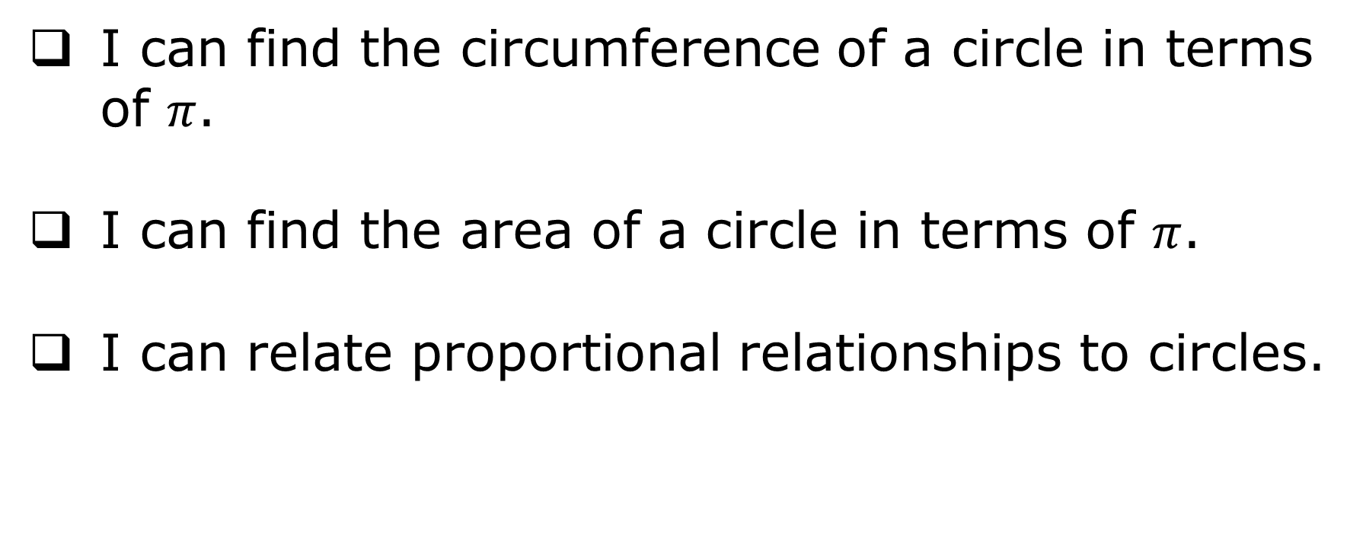
Learning Targets
I can find the circumference of a circle in terms of $π$.
I can find the area of a circle in terms of $π$.
I can relate proportional relationships to circles.
volume 2, pg. 192

Slide 5

Warm-Up
volume 2, pg. 192

Slide 6
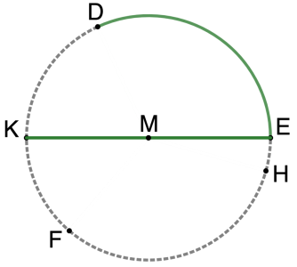
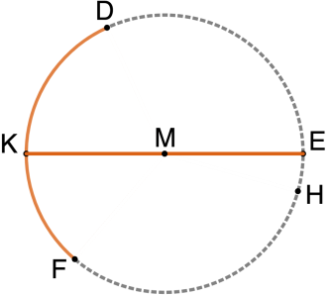
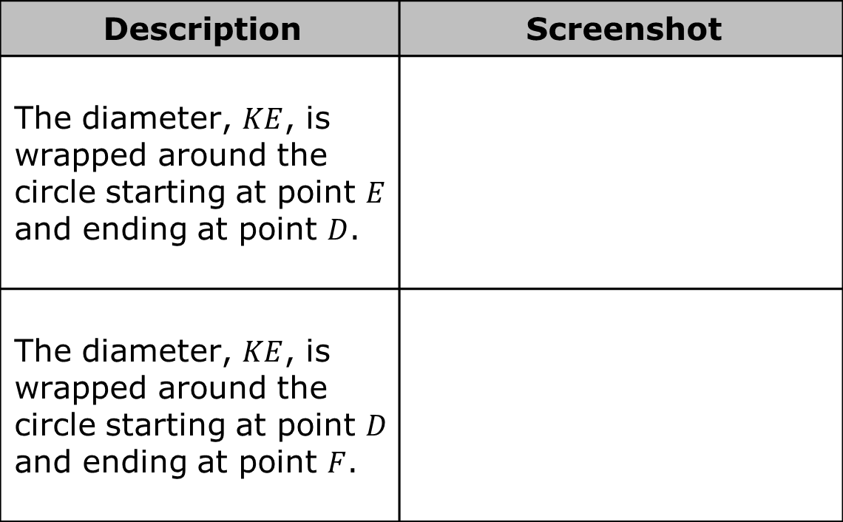
11.9.1 Warm-Up: Bell Work
A series of screenshots of Circle $M$ are shown. In each screenshot, the line segment and arc that are the same color have the same length.
Description | Screenshot
The diameter, $KE$, is wrapped around the circle starting at point $E$ and ending at point $D$.
The diameter, $KE$, is wrapped around the circle starting at point $D$ and ending at point $F$.
volume 2, pg. 192

Slide 7
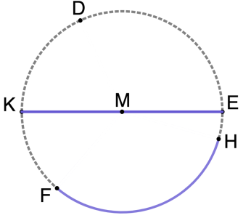
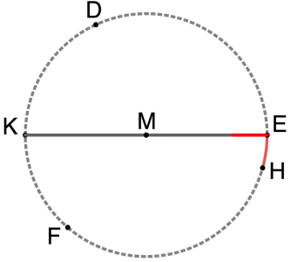
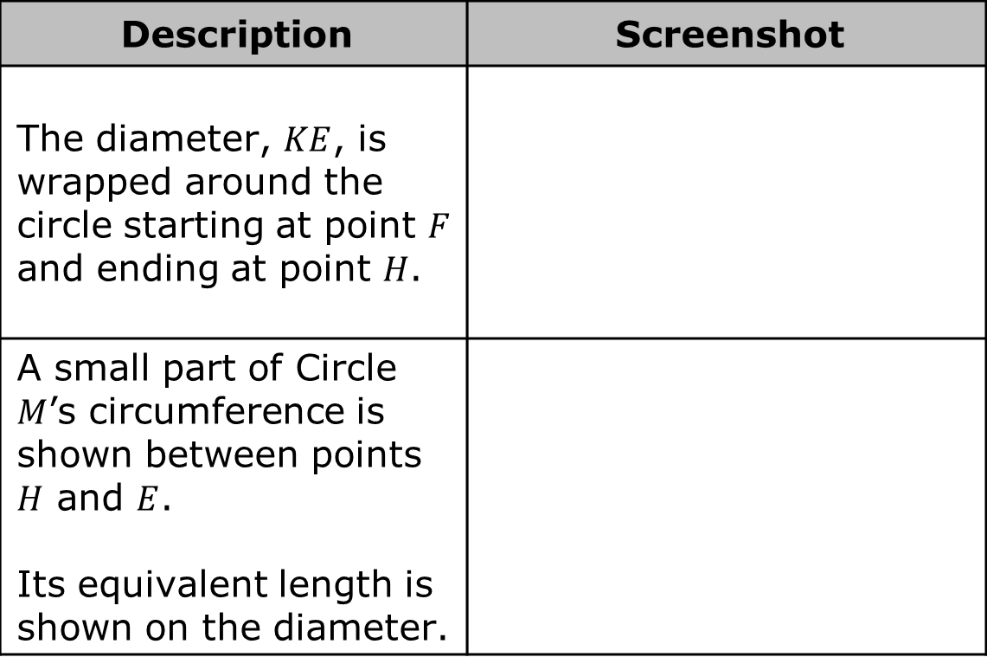
Description | Screenshot
The diameter, $KE$, is wrapped around the circle starting at point $F$ and ending at point $H$.
A small part of Circle $M$’s circumference is shown between points $H$ and $E$. Its equivalent length is shown on the diameter.
volume 2, pg. 192

Slide 8
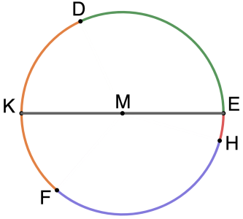
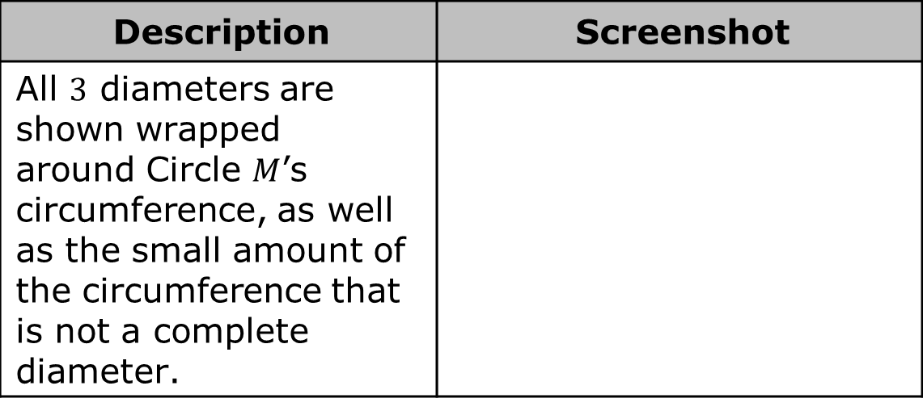
Description | Screenshot
All $3$ diameters are shown wrapped around Circle $M$’s circumference, as well as the small amount of the circumference that is not a complete diameter.
volume 2, pg. 193

Slide 9
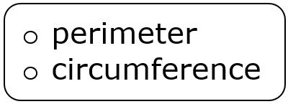
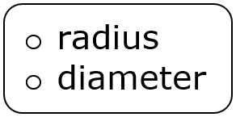
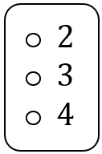
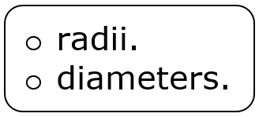
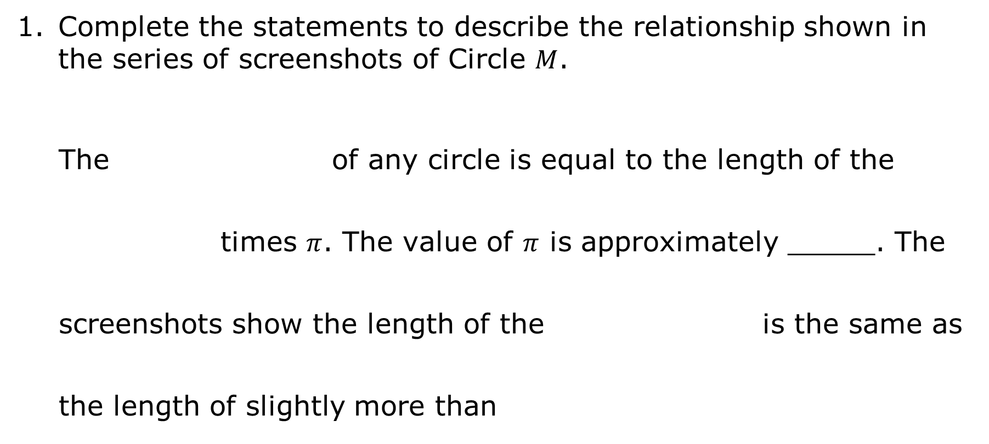
Complete the statements to describe the relationship shown in the series of screenshots of Circle $M$.
The of any circle is equal to the length of the times $π$. The value of $π$ is approximately _____. The screenshots show the length of the is the same as the length of slightly more than
volume 2, pg. 193

Slide 10
The part of the circumference that represents the small amount of the circumference that is not a complete diameter has an approximate length of ______.
volume 2, pg. 193

Slide 11

Exploration
volume 2, pg. 193

Slide 12


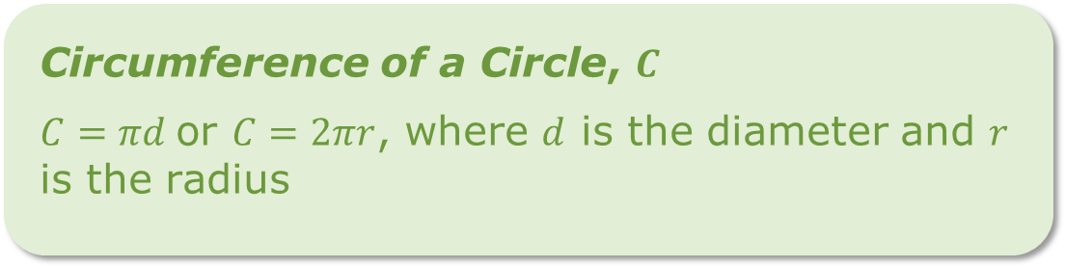

11.9.2 Exploration: Revisiting Relationships in Circles
The formulas for finding the circumference and area of a circle are shown.
Area of a Circle, $A$
$A=πr^{2}$, where $r$ is the radius
Circumference of a Circle, $C$
$C=πd$ or $C=2πr$, where $d$ is the diameter and $r$ is the radius
volume 2, pg. 193

Slide 13
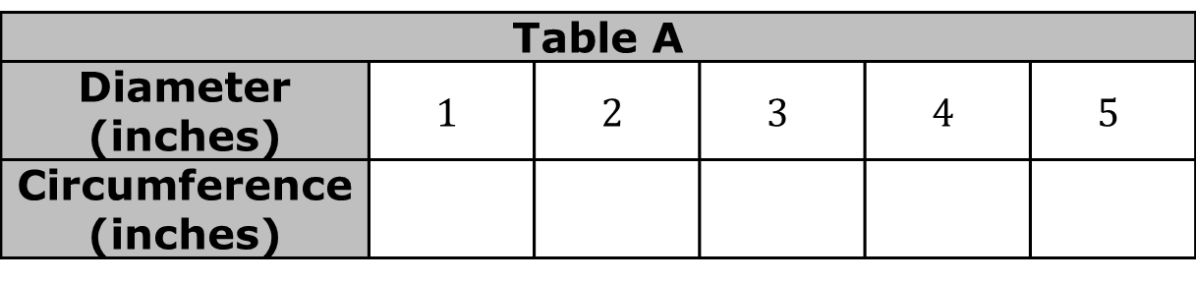
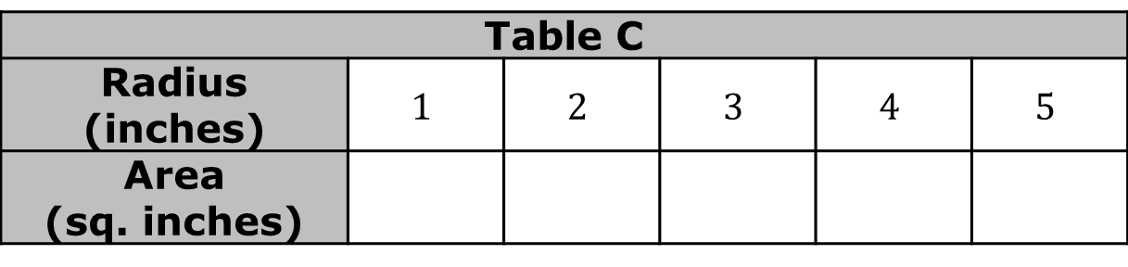
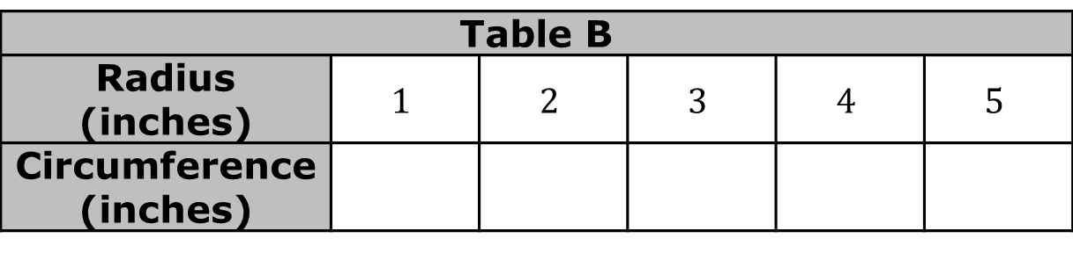
Work with your partner to complete each table of values in terms of $π$.
Table A
Diameter (inches) | $$1$$ | $$2$$ | $$3$$ | $$4$$ | $$5$$
Circumference (inches)
Table B
Radius (inches) | $$1$$ | $$2$$ | $$3$$ | $$4$$ | $$5$$
Circumference (inches)
Table C
Radius (inches) | $$1$$ | $$2$$ | $$3$$ | $$4$$ | $$5$$
Area (sq. inches)
volume 2, pg. 193

Slide 14
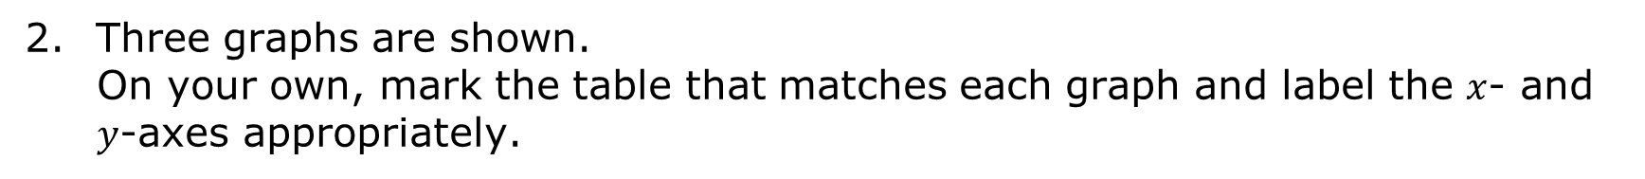
Three graphs are shown.
On your own, mark the table that matches each graph and label the $x$- and $y$-axes appropriately.
Graph | Table
 | Table A Table B Table C
volume 2, pg. 194

Slide 15
Graph | Table
 | Table A Table B Table C
volume 2, pg. 194

Slide 16
Graph | Table
 | Table A Table B Table C
volume 2, pg. 194

Slide 17
Check your work with your partner and if necessary, resolve any differences.
Discuss with your partner which relationships appear to be proportional, including what evidence there is to support your thinking. Then, summarize your discussion.
volume 2, pg. 194

Slide 18

Bring It Together
volume 2, pg. 195

Slide 19



11.9.3 Bring It Together: Revisiting Relationships in Circles
Complete the statements.
There a proportional relationship between the diameter and circumference of a circle.
volume 2, pg. 195

Slide 20
There a proportional relationship between the radius and circumference of a circle.
There a proportional relationship between the radius and area of a circle.
volume 2, pg. 195

Slide 21

Collaboration
volume 2, pg. 195

Slide 22

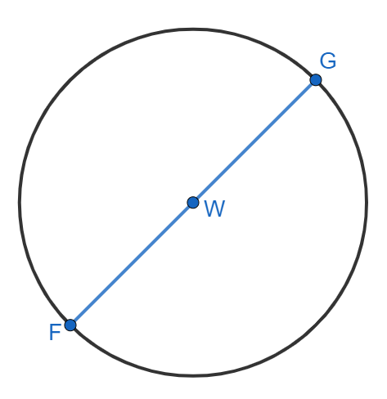
11.9.4 Collaboration: Diameter and Circumference
Circle $W$ is shown with diameter $FG$.
volume 2, pg. 195

Slide 23

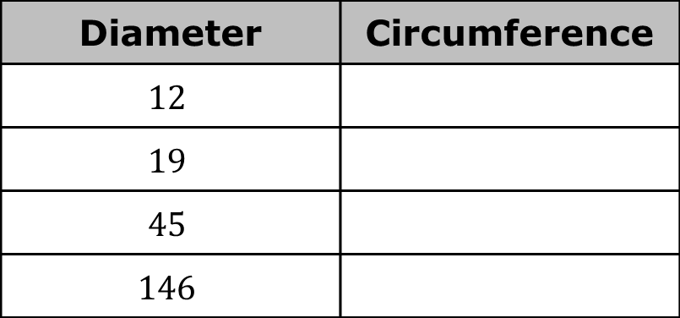
Miranda uses a drawing program to change the size of Circle $W$. Find the circumference, in terms of $π$, for each diameter she uses.
Suppose $x$ represents the diameter and $y$ represents the circumference. Write the constant of proportionality, $\frac{y}{x}$.
Diameter | Circumference
$$12$$
$$19$$
$$45$$
$$146$$
volume 2, pg. 195

Slide 24
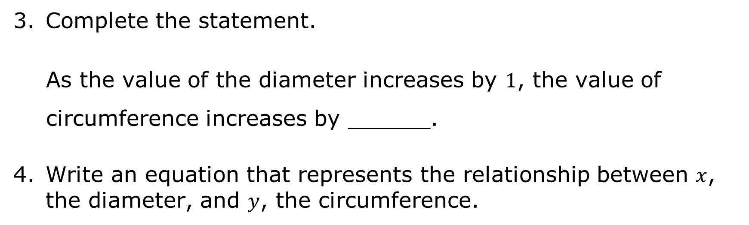
Complete the statement.
As the value of the diameter increases by $1$, the value of circumference increases by ______.
Write an equation that represents the relationship between $x$, the diameter, and $y$, the circumference.
volume 2, pg. 196

Slide 25

Wrap-Up
volume 2, pg. 196

Slide 26
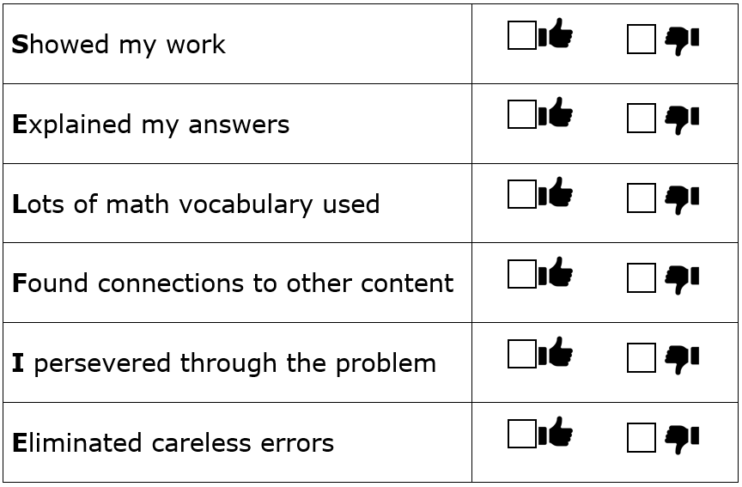
11.9.5 Wrap-Up: Reflection
Take a SELFIE by checking the box that best matches what you did today.
volume 2, pg. 196

